Slide 1


Smart NFC Card Application
Vast Expanse (Team 7)

Slide 2
Meet The Team
Wian du Plooy (u17237263) - Team Leader – Working Prototype
Duncan Vodden (u17037400) - Team Member – Landing Page, Slide Show, Subsystems (SRS) and Trace-ability Matrix
Tjaart Booyens (u17021775) - Team Member – User Characteristics, Subsystems (SRS), Quality requirements and Trace-ability Matrix
Savvas Panagiotou (17215286) - Team Member – Use Cases
Jared O’Reilly (17051429) - Team Member – Introduction, Domain Model and functional Requirements

Slide 3
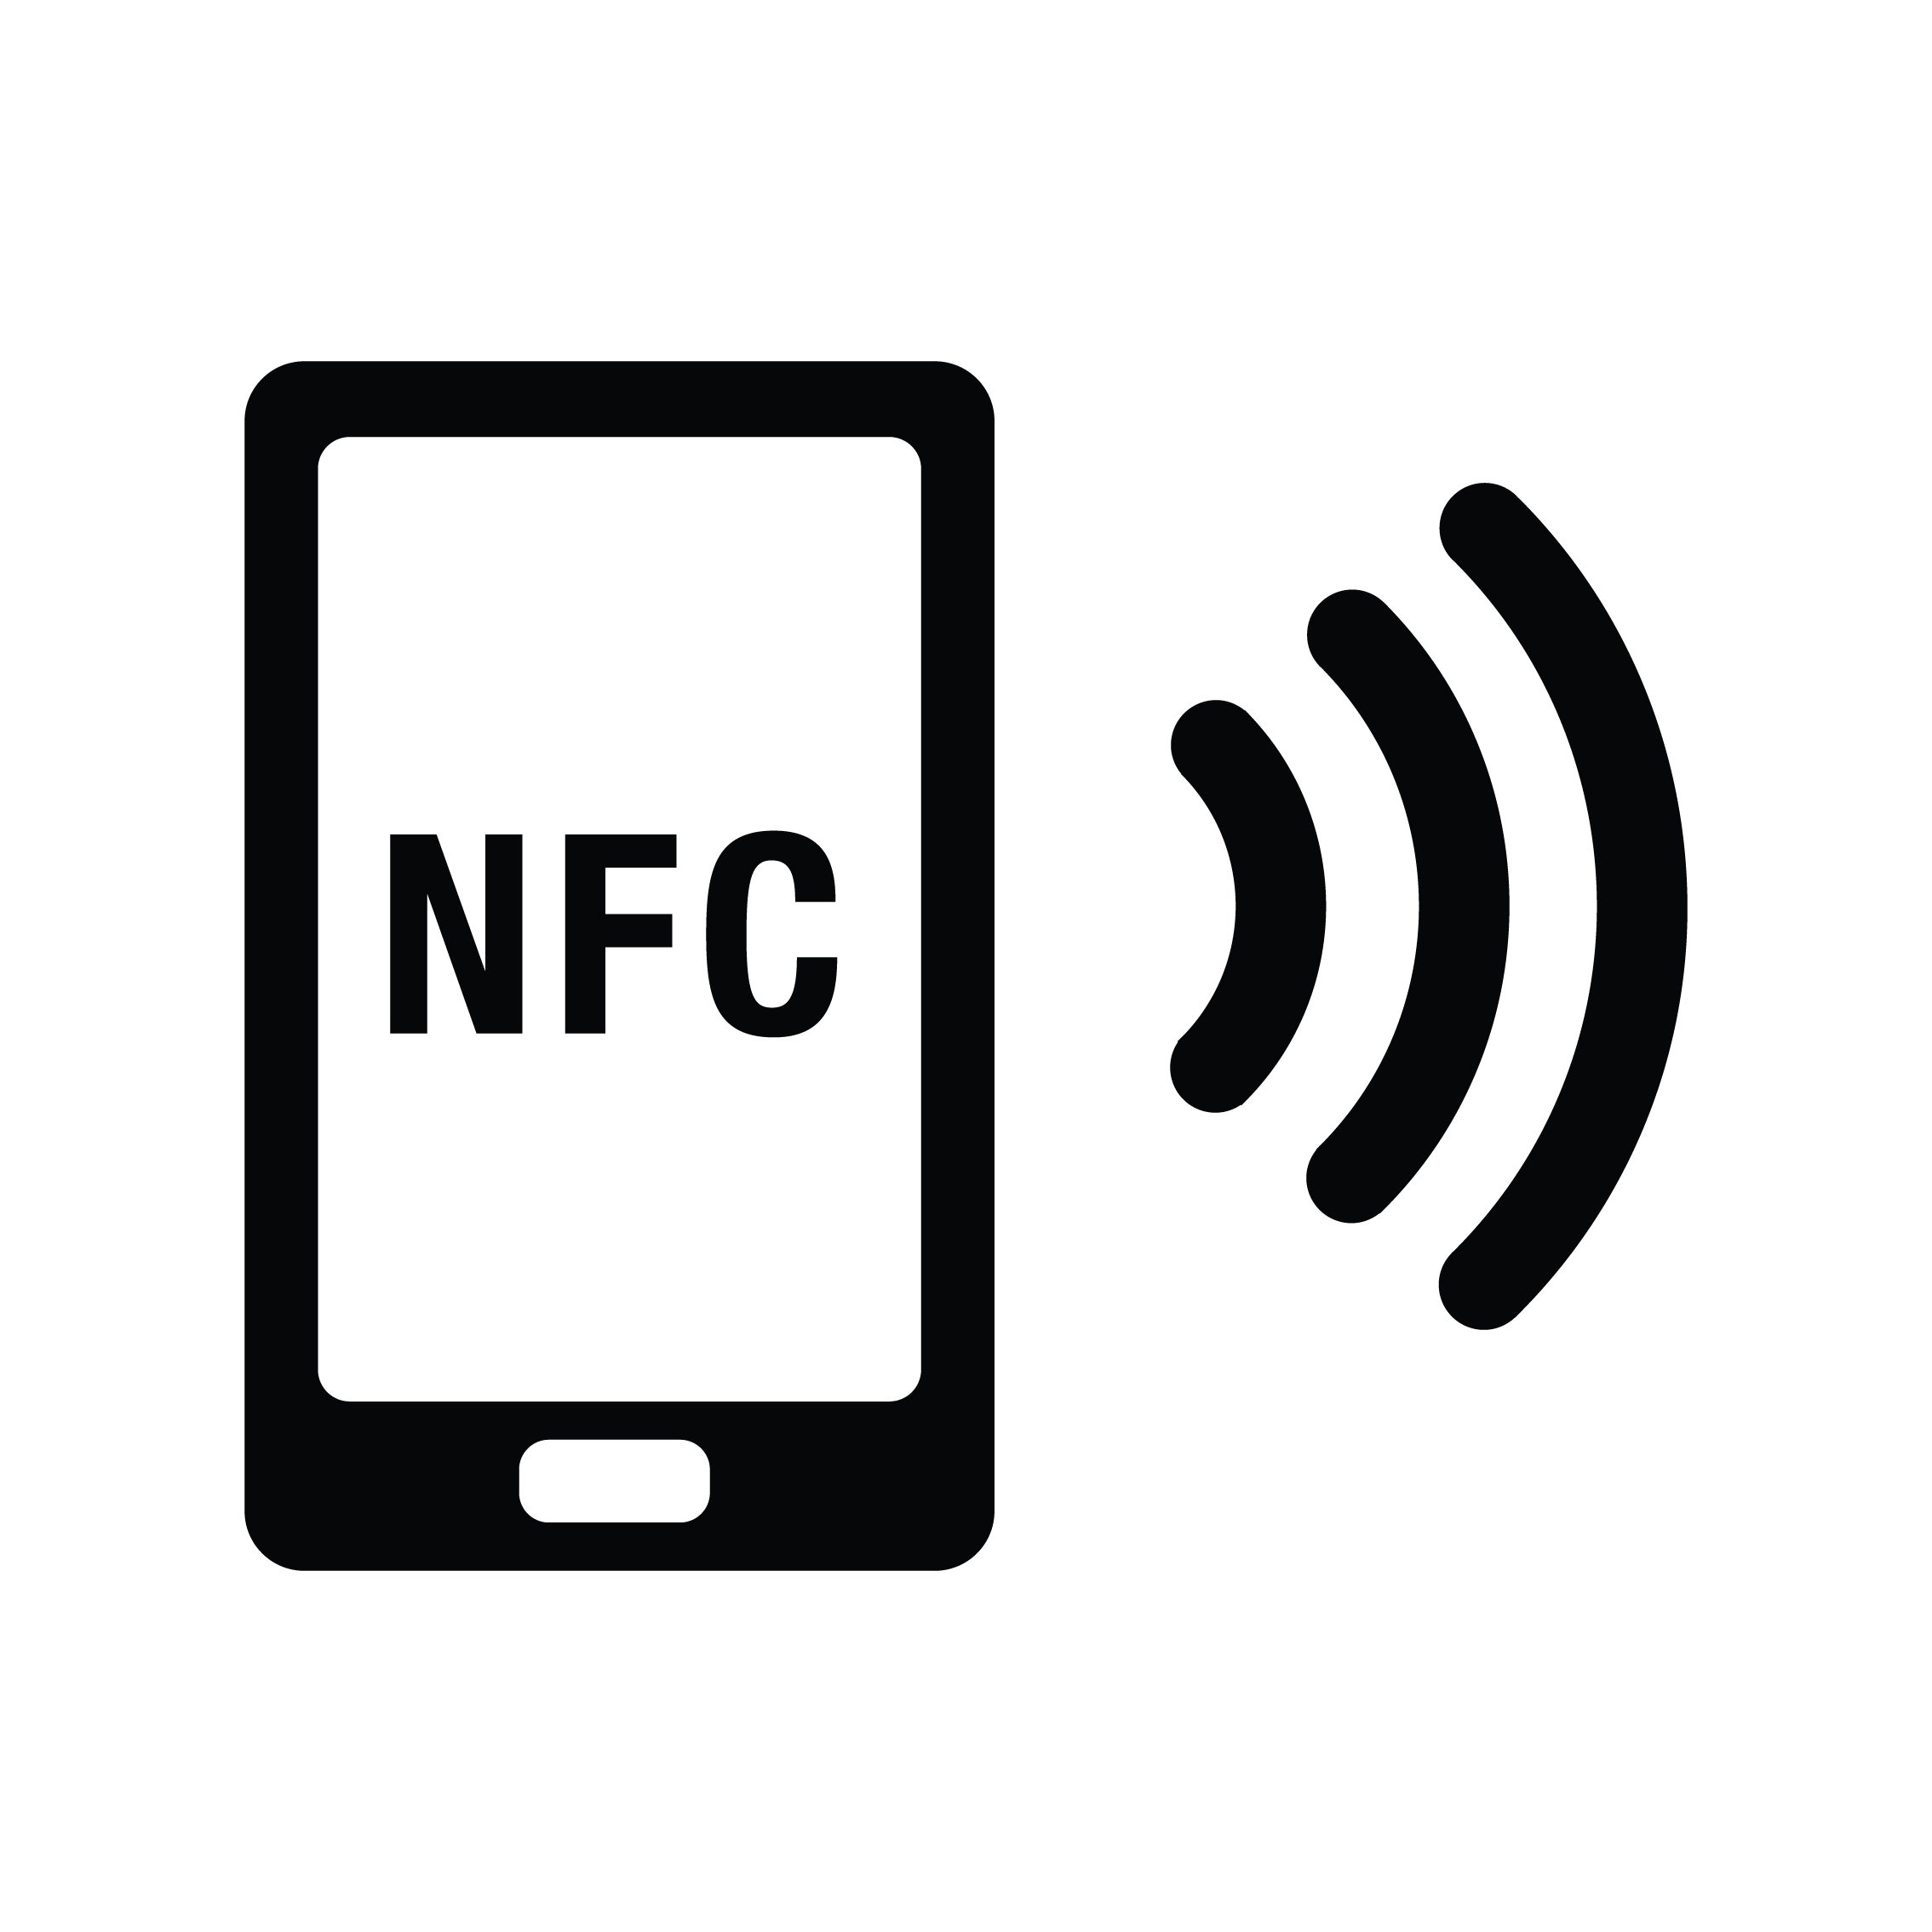
Project Description
Our Smart NFC application is aimed to maximize the use of NFC technology in the office environment
Business card details as well as the location of the business which will open the location
Allow guests to have temporary access control to a businesses property
The app will also allow the sharing of Wi-Fi details in order for guests to connect to the Wi-Fi of a business
Allows users to load credits onto a employee/guests account in the purpose of in-office purchases for cashless transactions.

Slide 4
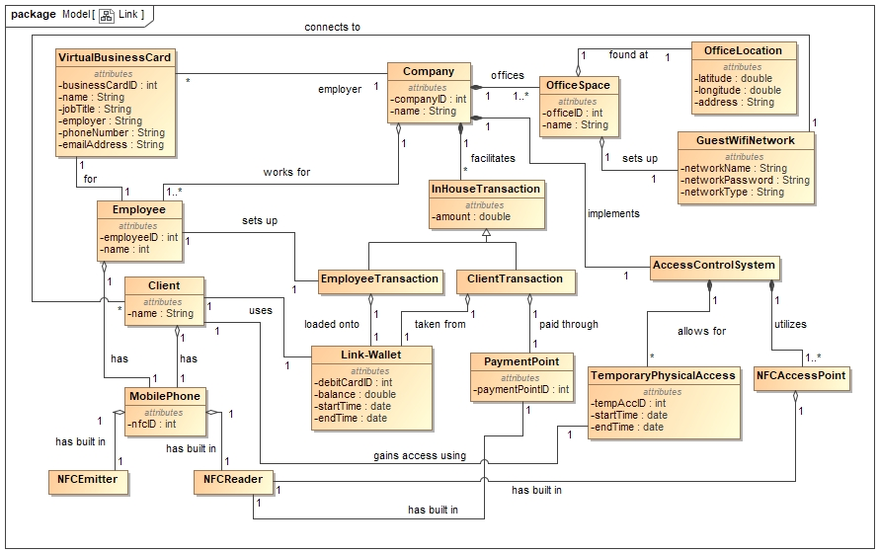
Domain Model

Slide 5


Use Cases and Demo
Use Cases for Demo 1
Ability to create a Business card
Ability to share a business card between phones
Ability to View business cards on a phone

Slide 6
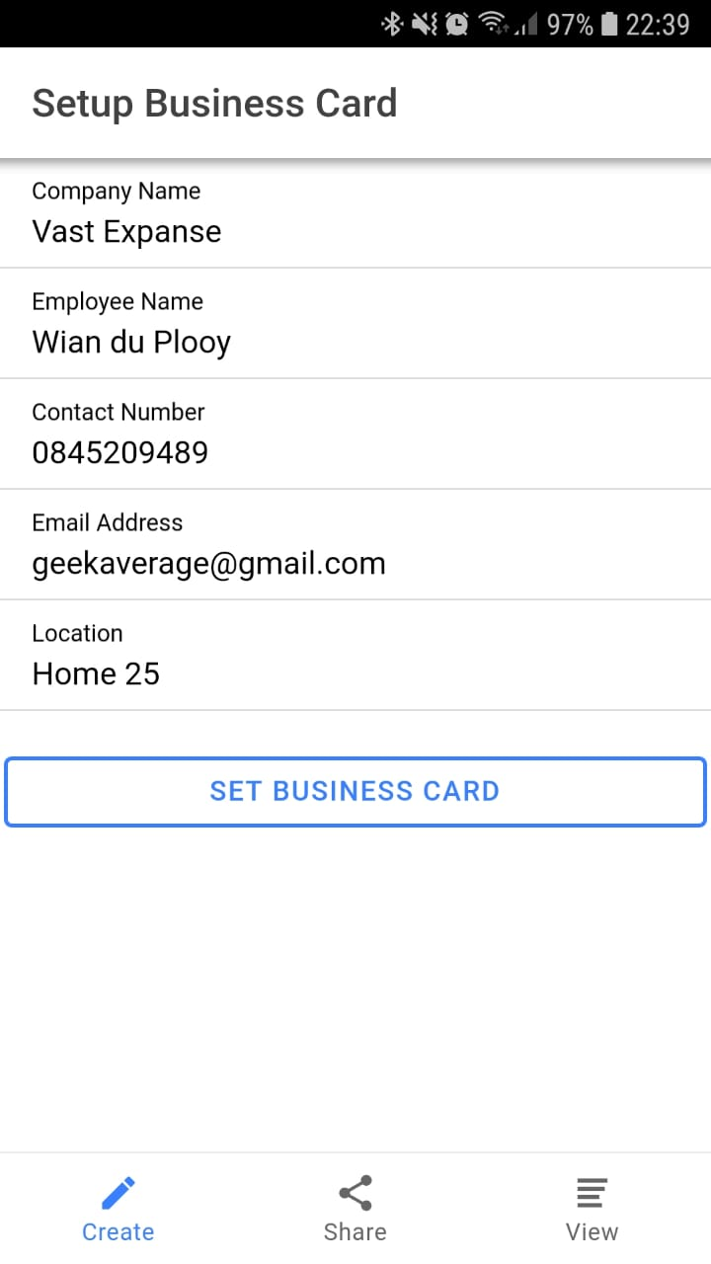
Ability to create a Business card

Slide 7
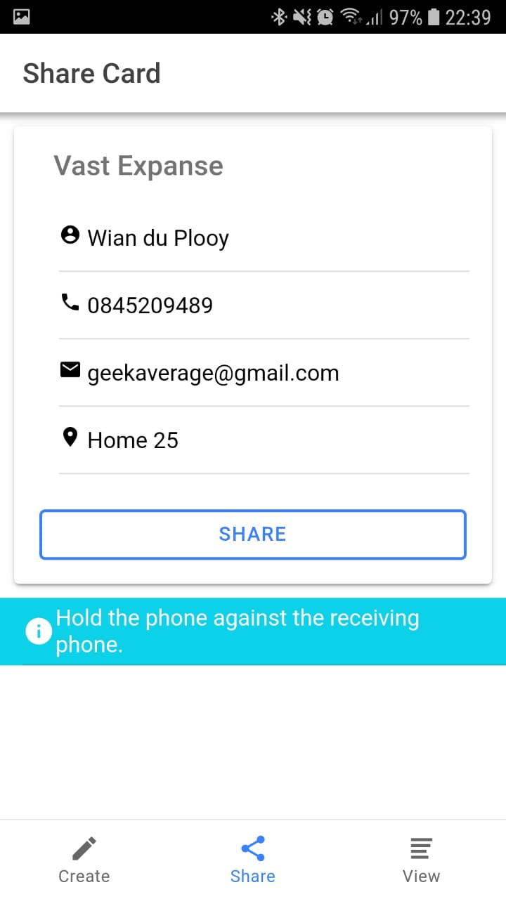
Ability to share a Business Card between phones

Slide 8
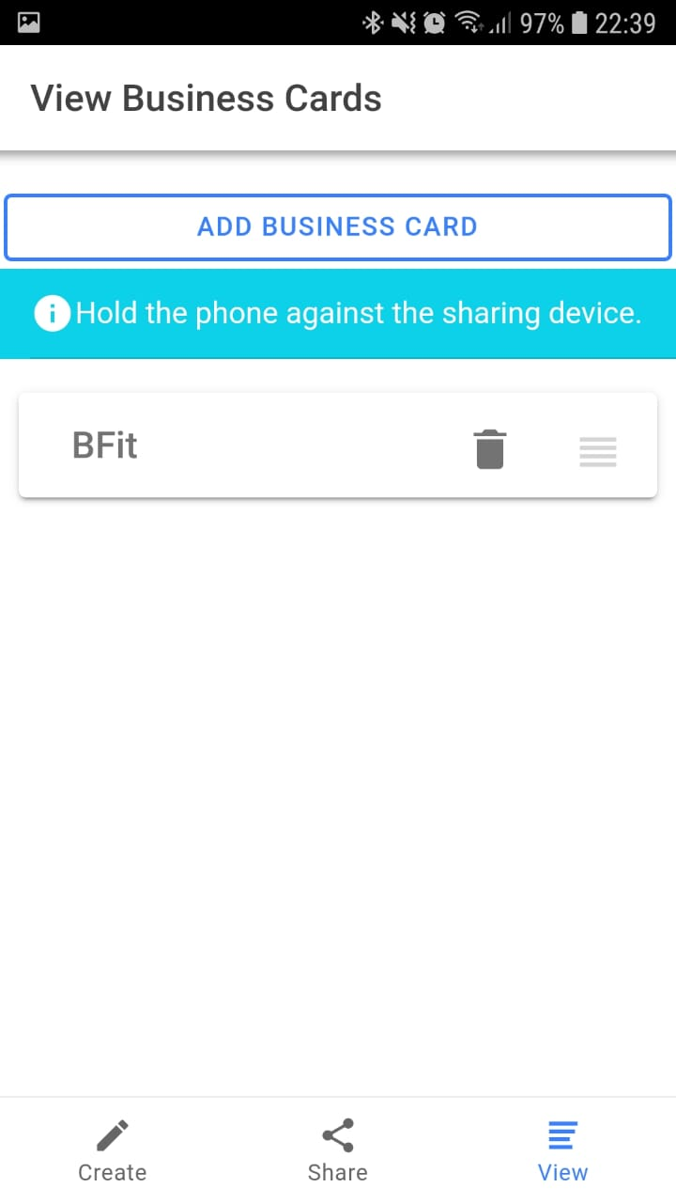
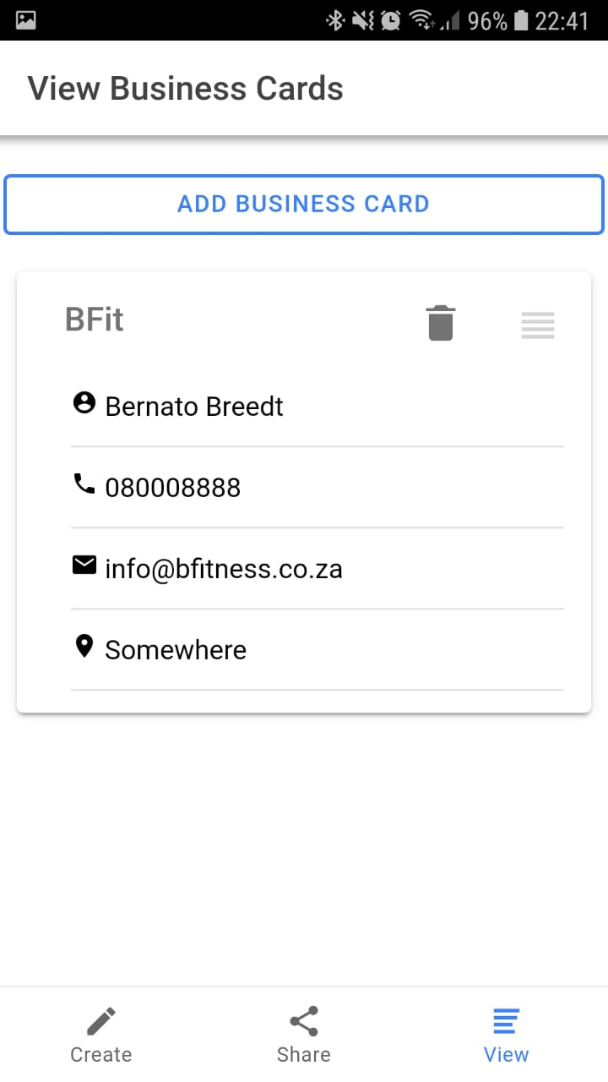
Ability to View Business Cards

Slide 9


Automated Testing
Unit Testing
Integration Testing
Open Source Testing framework for JavaScript
A hosted, distributed continuous integration service
Used to build and test software projects hosted on GitHub

Slide 10
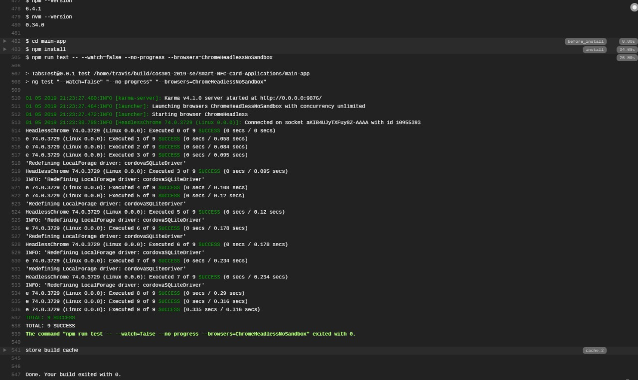

Slide 11
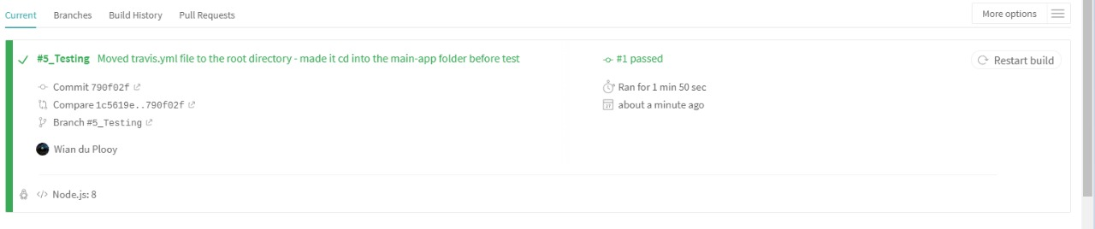

Slide 12
Thank You, Any Questions ?

